Slide 1

Variational Mixture of HyperGenerators for Learning Distributions over Functions
Ignacio Peis
ipeaz@dtu.dk
Technical University of Denmark
Honolulu, Hawaii
July 2023

Slide 2

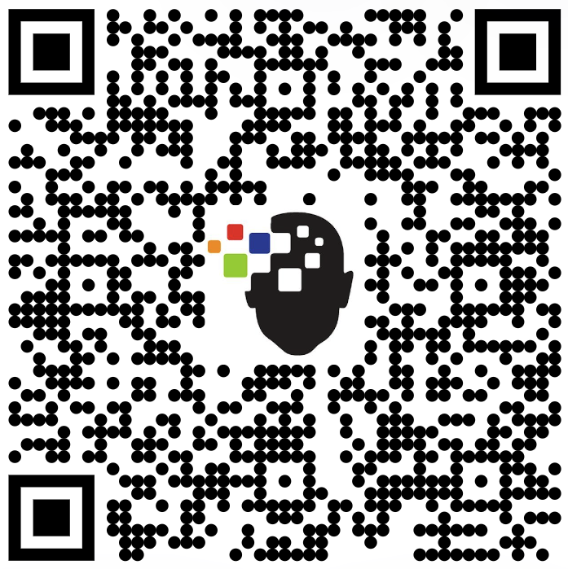

Collaborators
Batuhan Koyuncu¹ Pablo Sánchez^{1,2} Ignacio Peis³ Pablo M. Olmos⁴ Isabel Valera^{1,5}
[Paper]
[Code]
¹ University of Saarland
² Max Planck Institute for Intelligent Systems
³ Technical University of Denmark (DTU)
⁴ Universidad Carlos III de Madrid
⁵ Max Planck Institute for Software Systems

Slide 3
Deep Generative Models
Learning probability distributions on data using Deep Neural Networks.
Implicitly
Explicitly
Generative Adversarial Networks (GANs [1])
Variational Autoencoders (VAEs [2])
Denoising Diffusion Probabilistic Models (DDPMs [3])
Score-based models [4]
Energy-based models [5]
[1] (Goodfellow et al., 2014)
[2] (Kingma et al., 2014)
[3] (Ho et al., 2020)
[4] (Song et al., 2019)
[5] (Lecun et al., 2006)

Slide 4
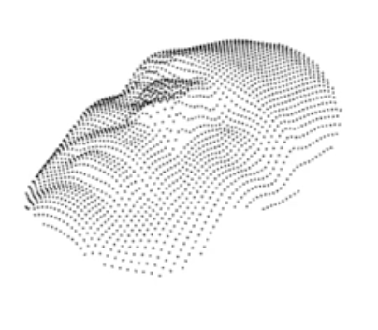
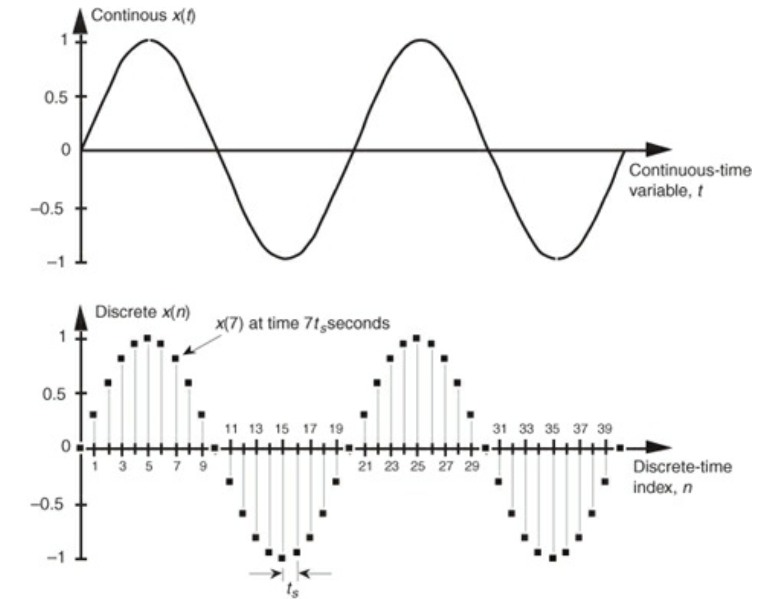
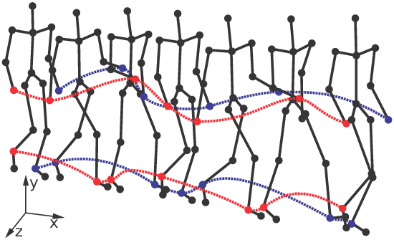
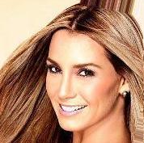
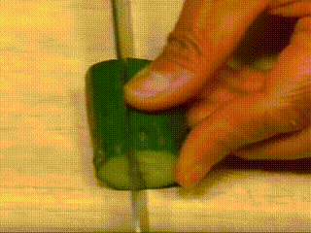
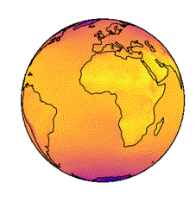

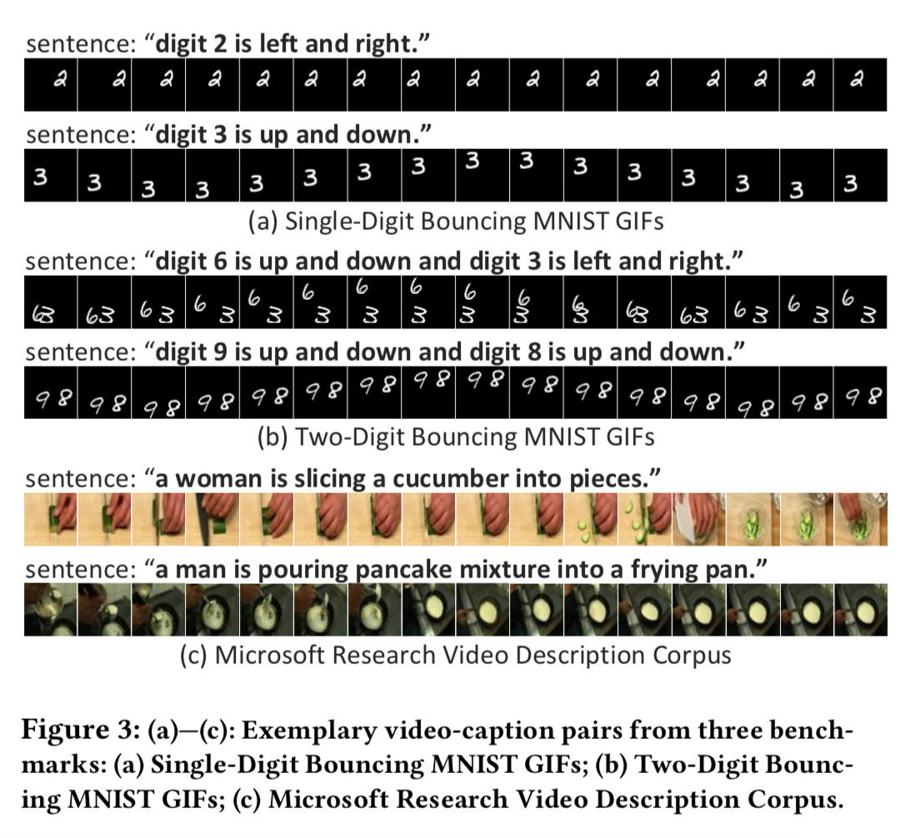
Discretization of data
We typically deal with discretized versions of data that are continuous in nature.
3D shapes
Signals
Motion sequences
2D Images
Videos
Polar data
Audios
Spatial
Temporal
Spatio-temporal

Slide 5


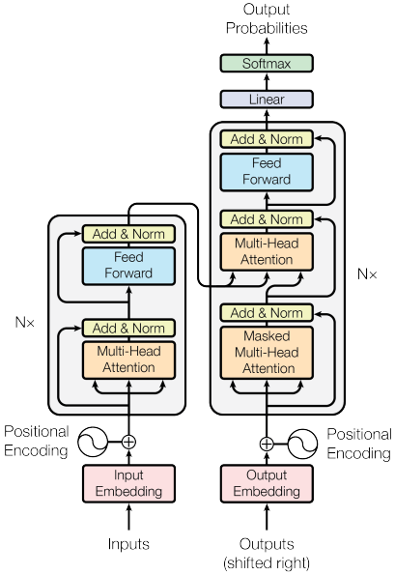
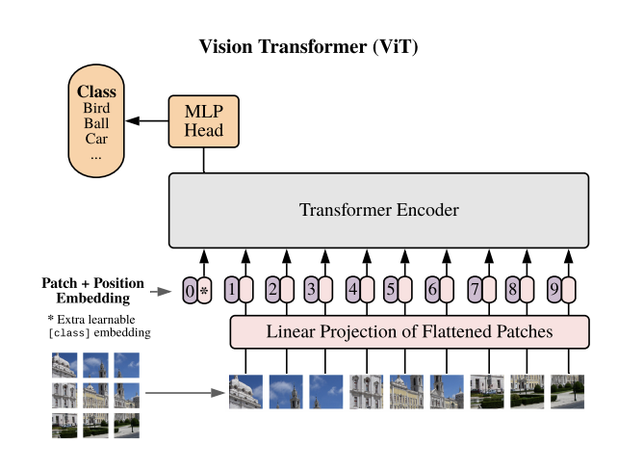
NNs to exploit discretized data
DNNs are tailored to the data nature.
CNNs, Vision Transformers
RNNs, Transformers
CNNs, RNNs, Transformers
[8]
[6]
[7]
[9]
Spatial
Temporal
Spatio-temporal
[6] (Simonyan et al., 2014)
[7] (Dosovitskiy et al., 2020)
[8] (Hochreiter et al., 1997)
[9] (Vaswani et al., 2017)

Slide 6
Real data is continuous in nature
What if we approximate the underlying continuous functions?

Slide 7
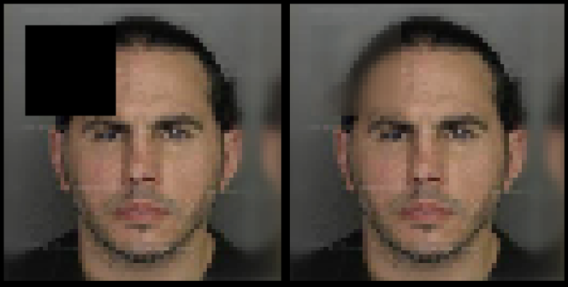
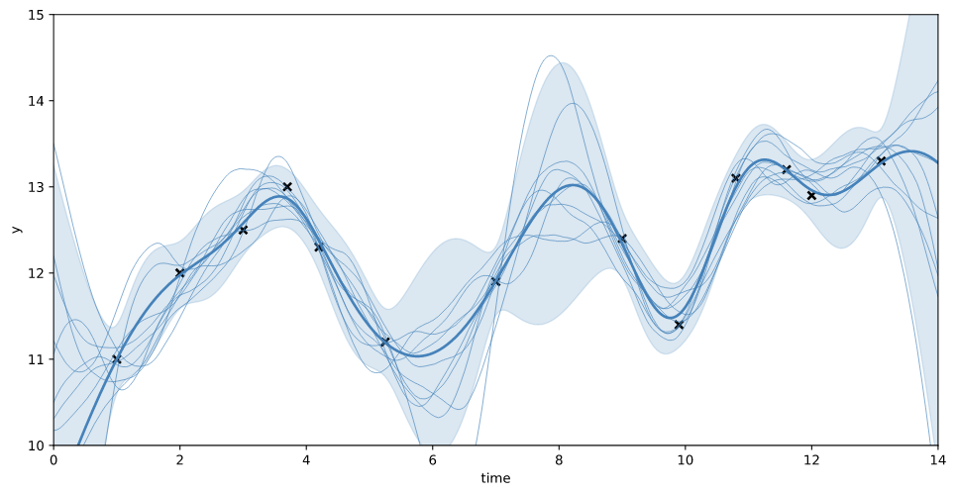
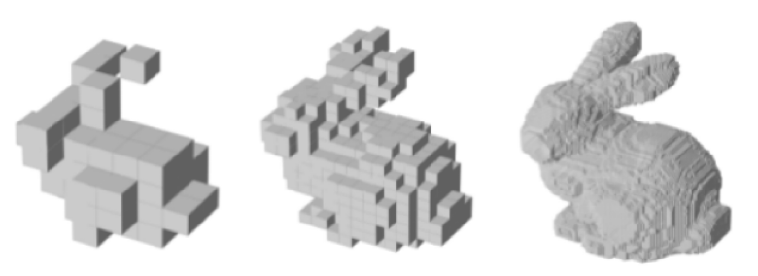
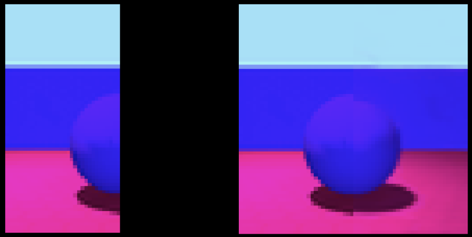
Real data is continuous in nature
Learning the distribution of a function allows for naturally handling:
We can use the same neural architecture independently of the data nature.
Information to store will be independent of the data size.
Inpainting
Super-resolution
Conditional generation
Outpainting

Slide 8
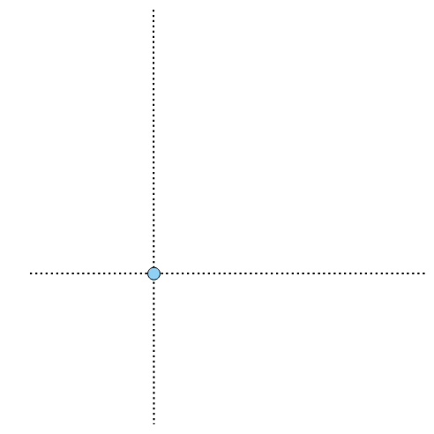

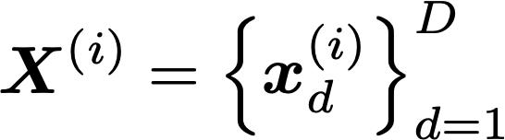
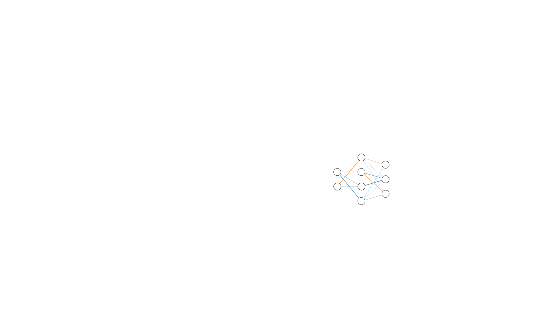
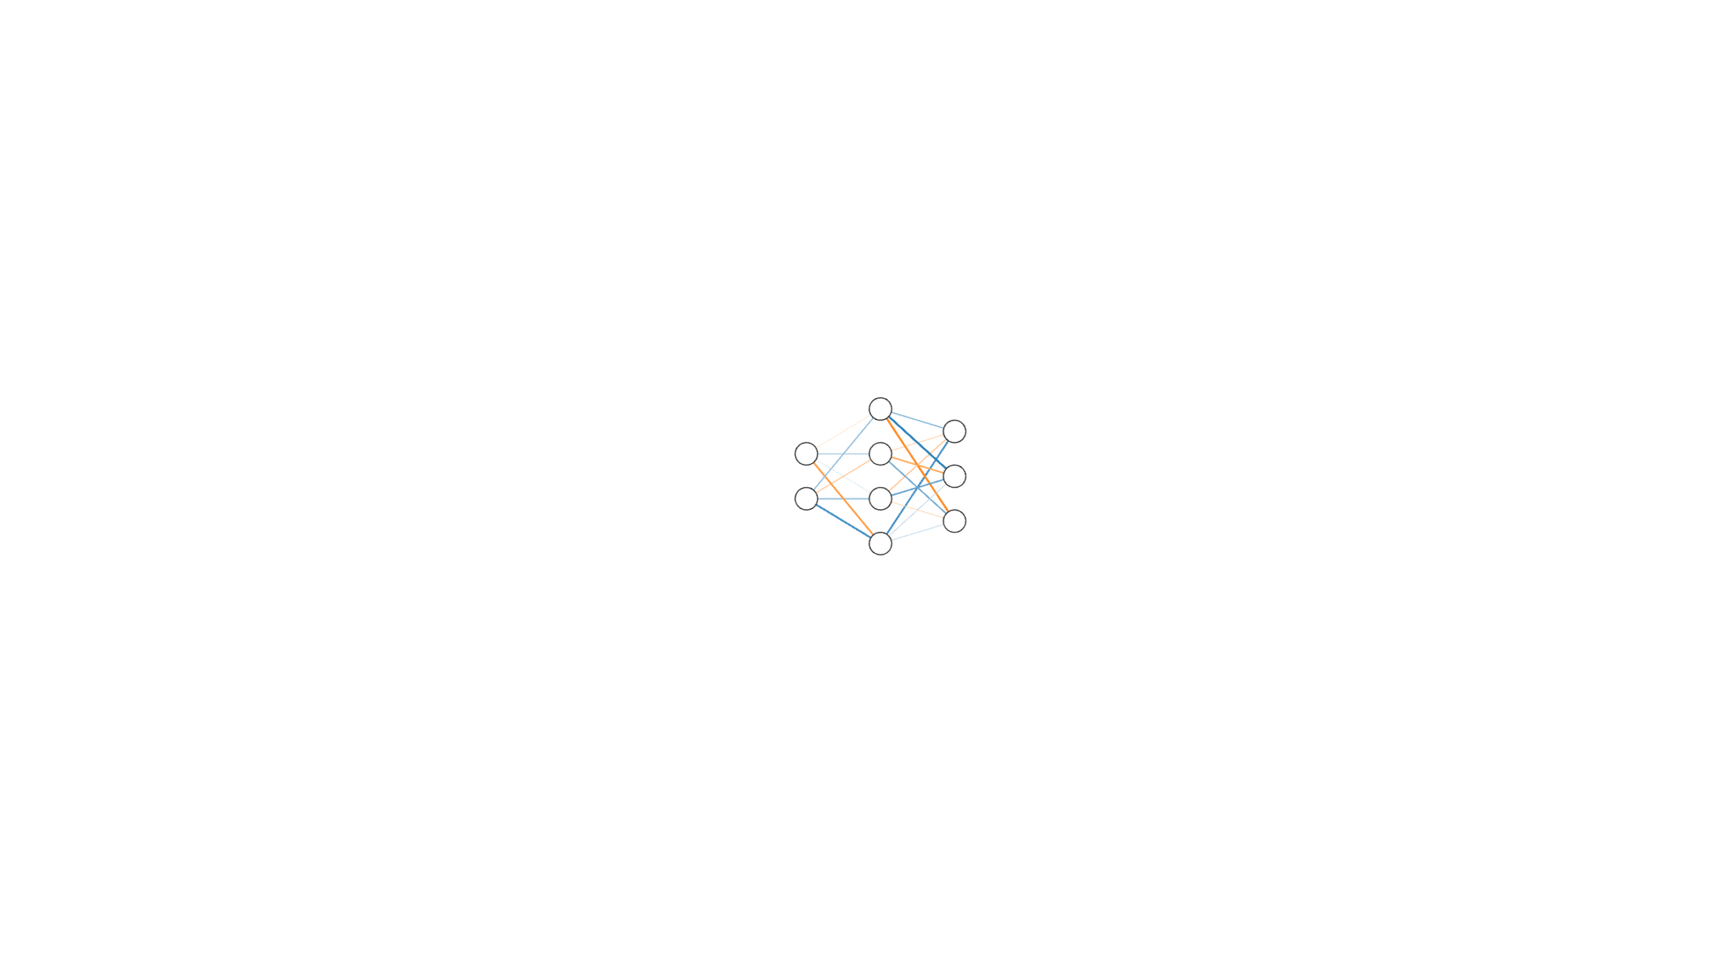
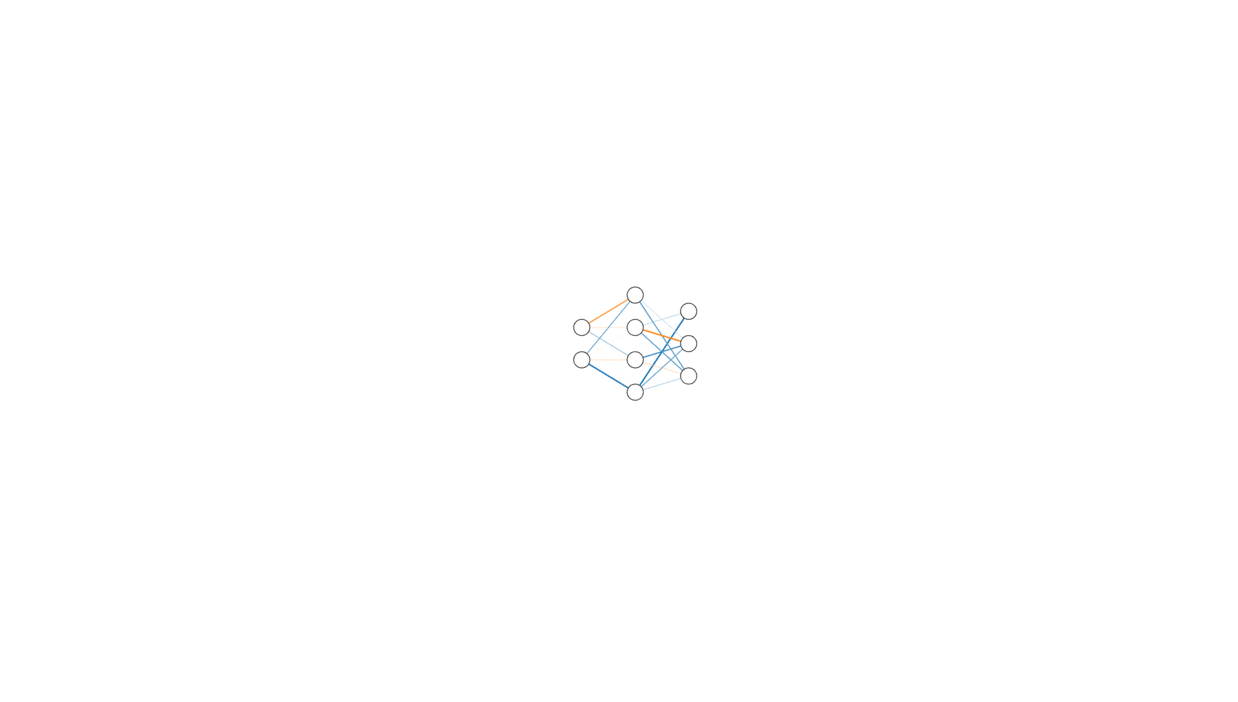
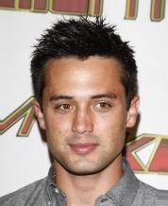
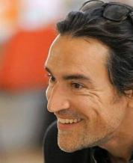
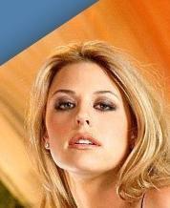
Implicit Neural Representations
INRs [10-12] can approximate these functions.
How to efficiently learn unique INRs per datapoint?
DGM that generate weights!
[10] (Sitzmann et al., 2020)
[11] (Mescheder et al., 2019)
[12] (Stanley et al., 2007)

Slide 9
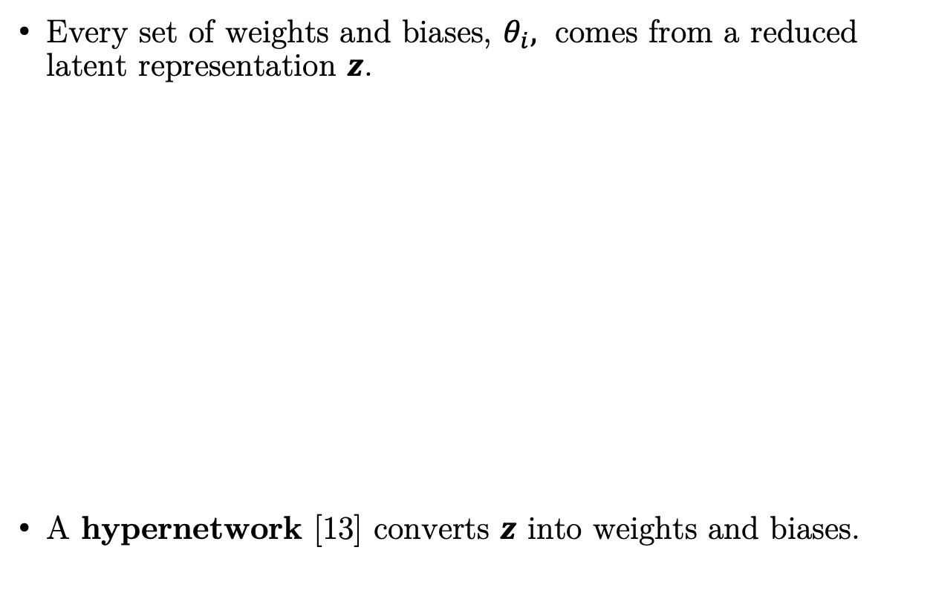
Our proposed method
Every set of weights and biases, $θ_{i},$ comes from a reduced latent representation $z$.
A hypernetwork [13] converts $z$ into weights and biases.
[13] (Ha et al., 2017)

Slide 10
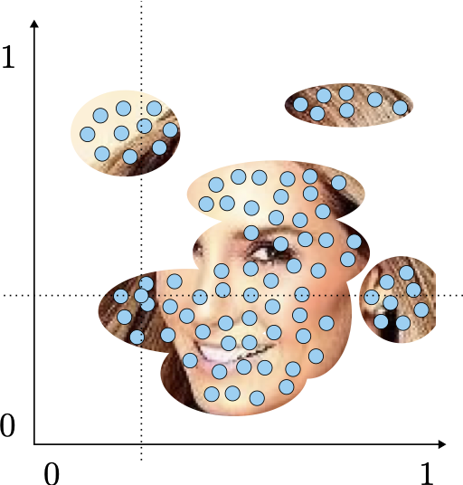
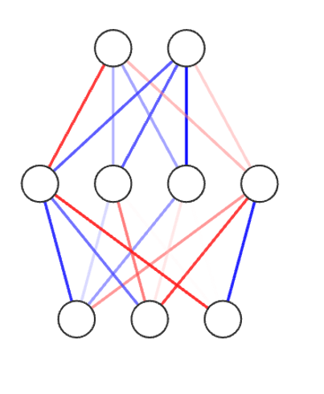
Our proposed method
To learn the parameters of our model, we opt by using Amortized Variational Inference, and optimize the following ELBO.
Point Convolutional encoder [14]
[14] (Wu et al., 2019)

Slide 11
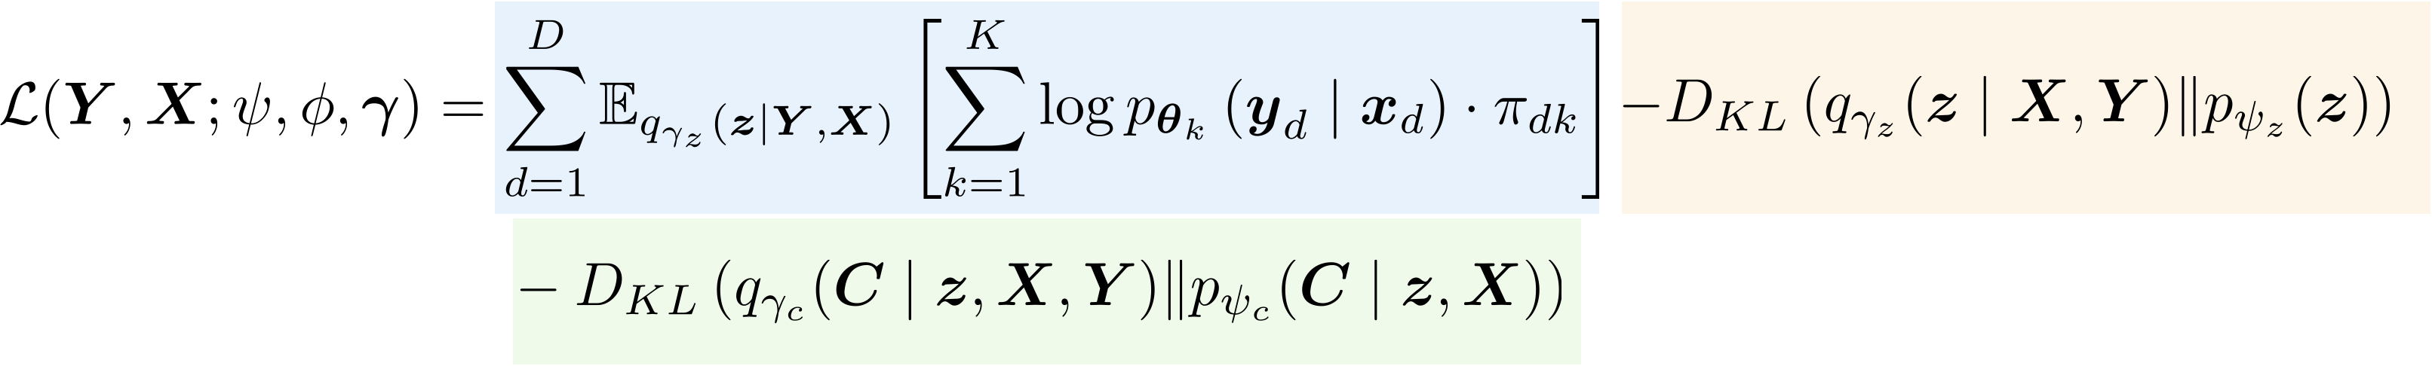
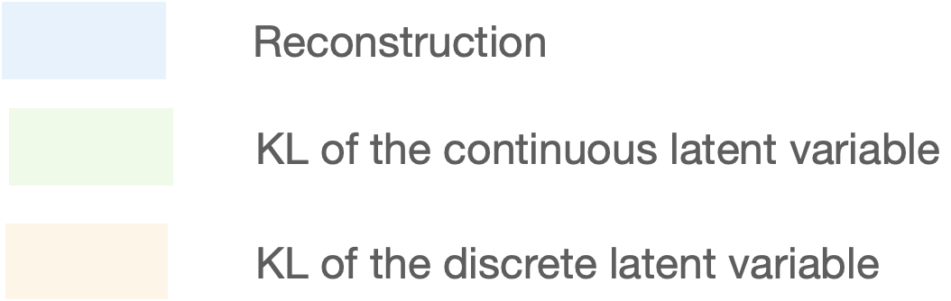
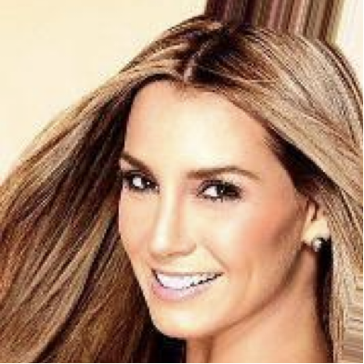
Our proposed method
We incorporate a Mixture of HyperGenerators for increased flexibility.
component

Slide 12
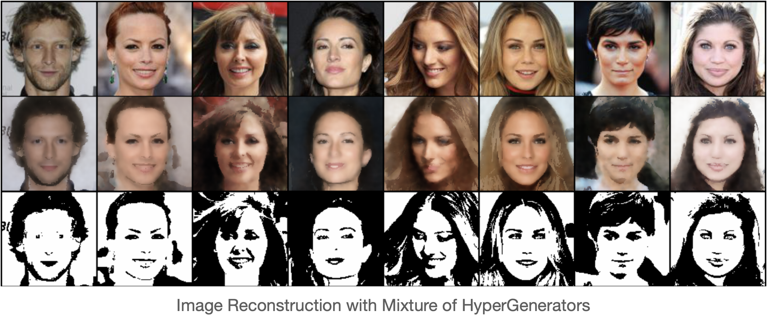
Our proposed method
We incorporate a Mixture of HyperGenerators for increased flexibility.

Slide 13
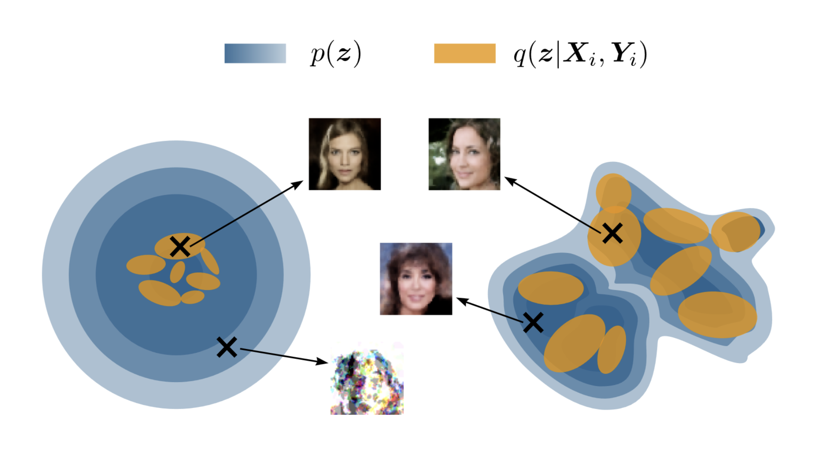
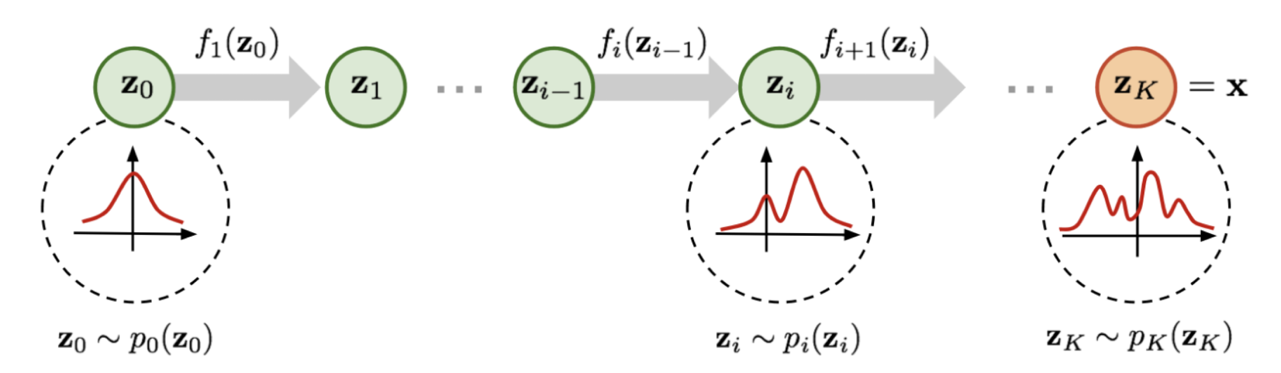
Our proposed method
To alleviate the holes problem, similarly like Latent Diffusion models [15], we learn the prior as a planar Flow [16].
[15] (Rombach et al., 2022)
[16] (Rezende et al., 2015)

Slide 14
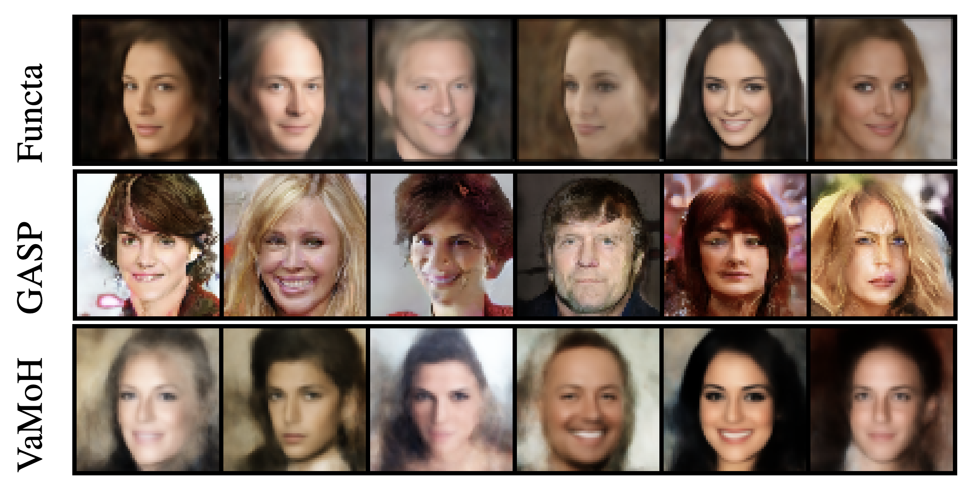
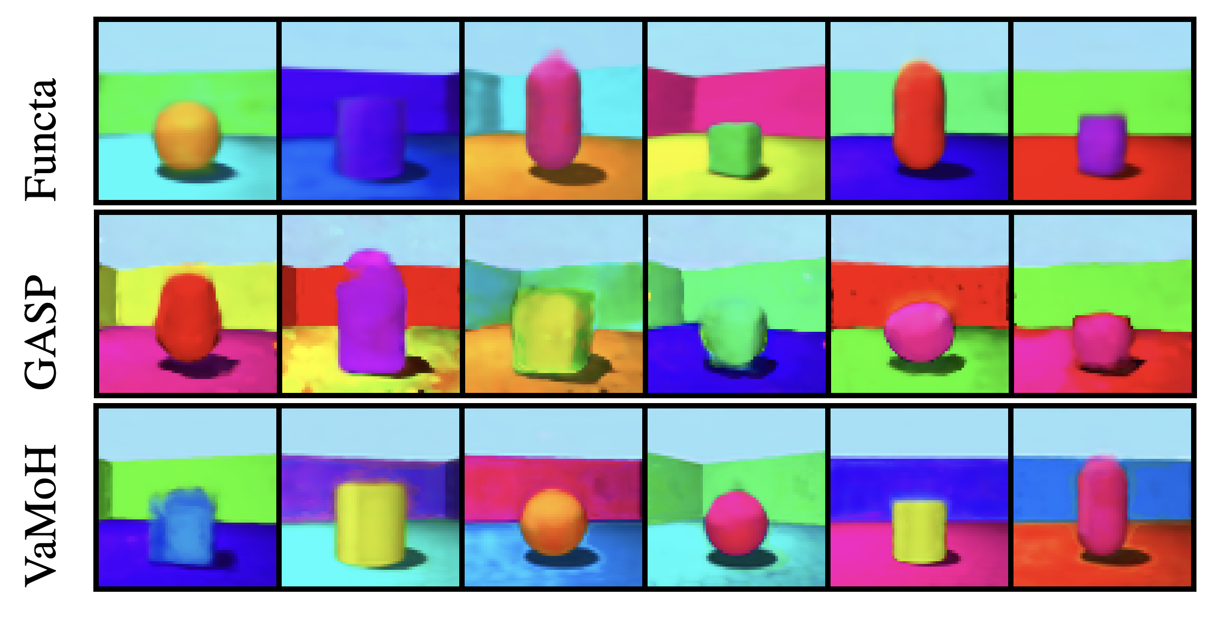
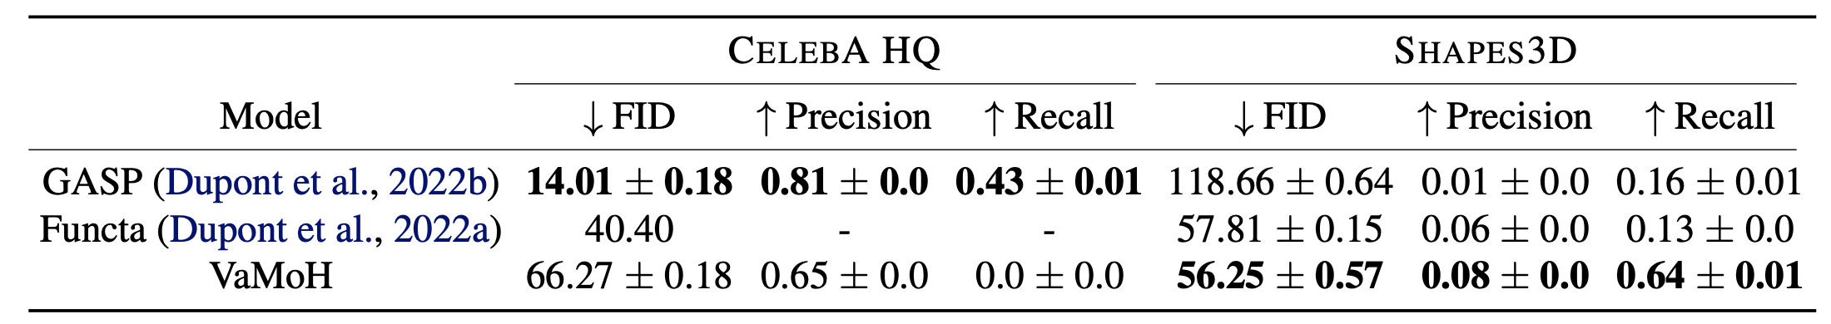
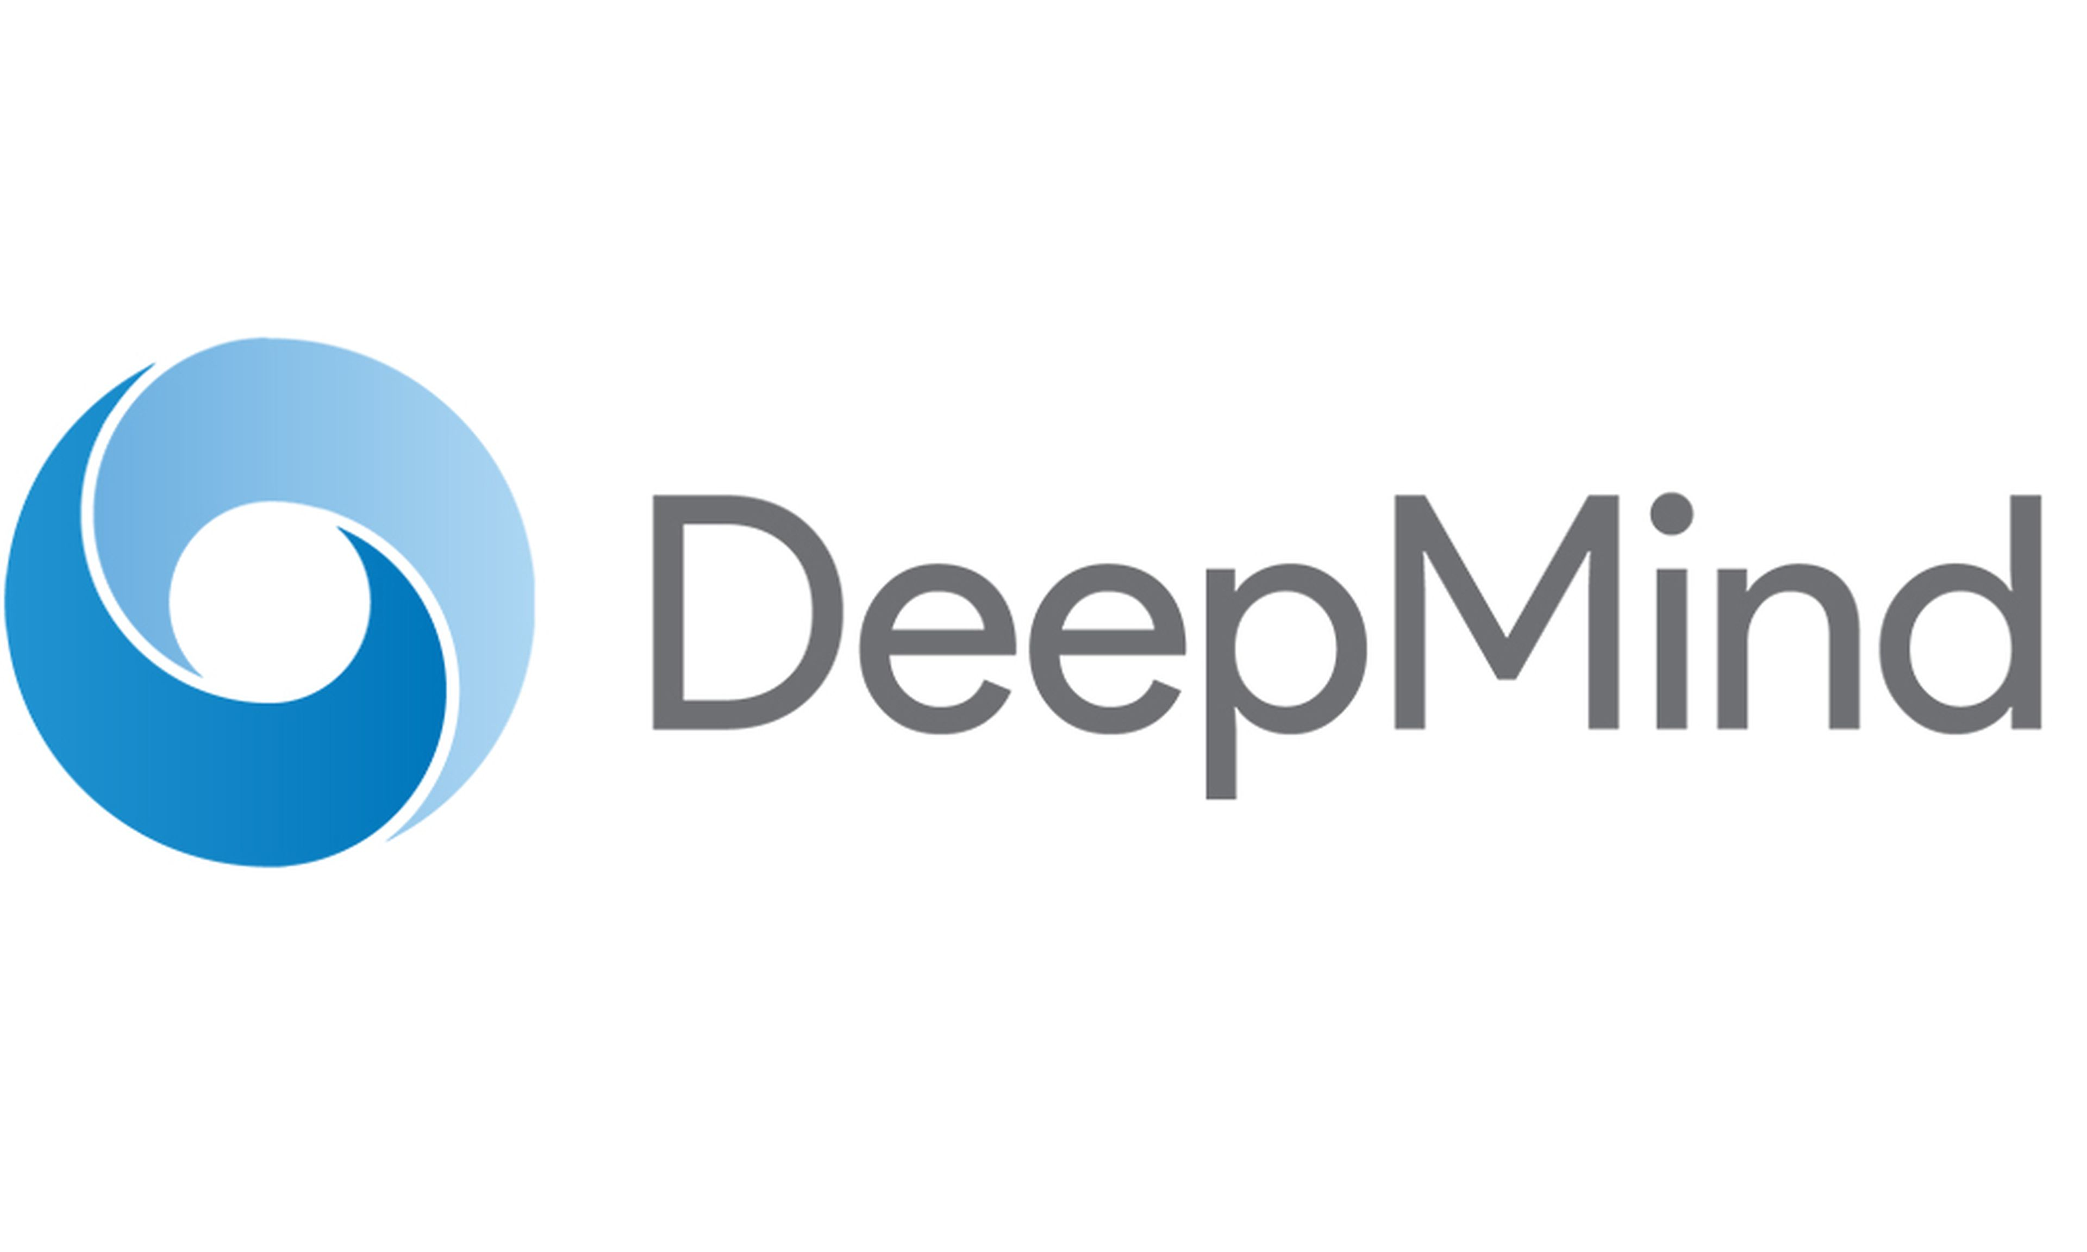
Results
We achieve comparable sampling quality and diversity wrt baselines.
[17]
[18]
[17] (Dupont et al., 2022a)
[18] (Dupont et al., 2022b)

Slide 15
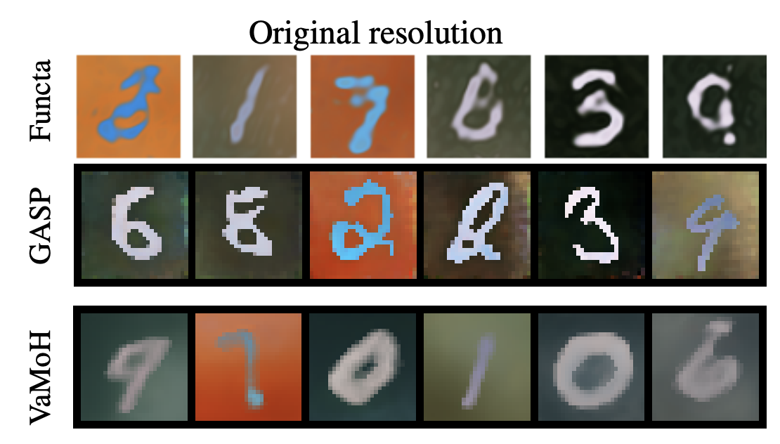
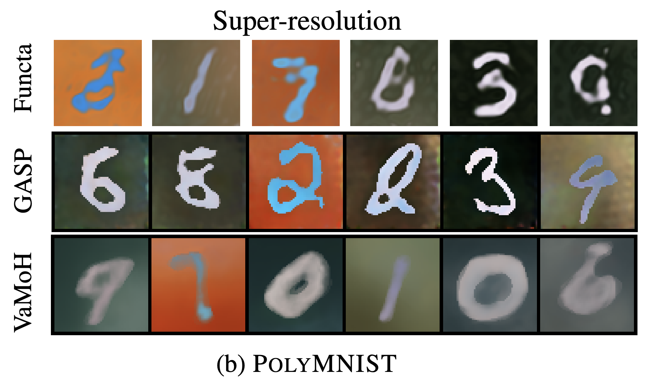
Results
We naturally generate samples with any desired resolution.

Slide 16
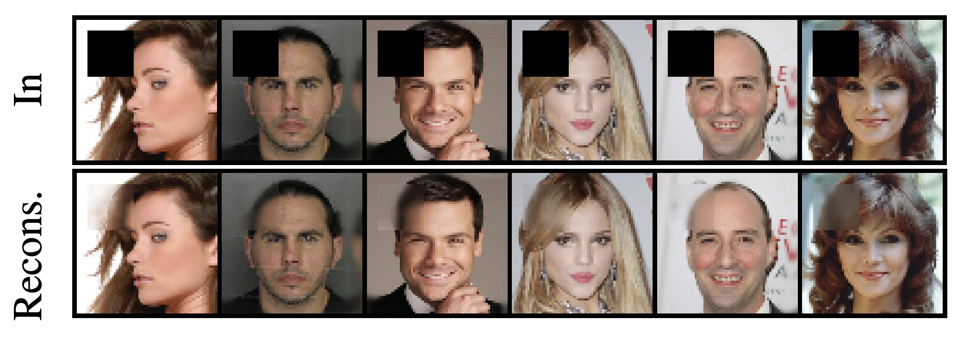
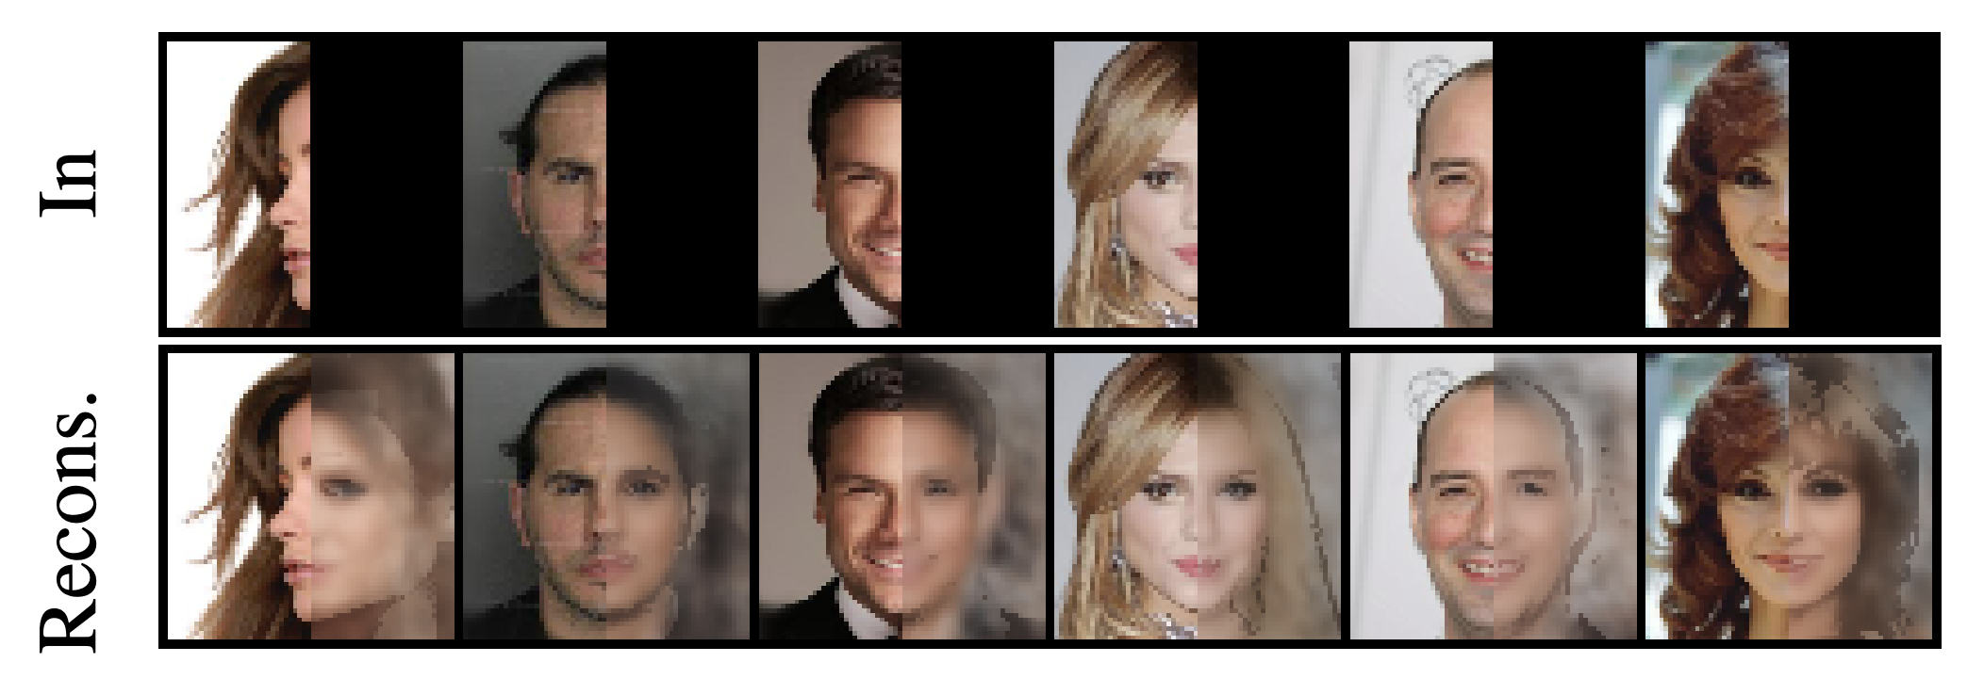
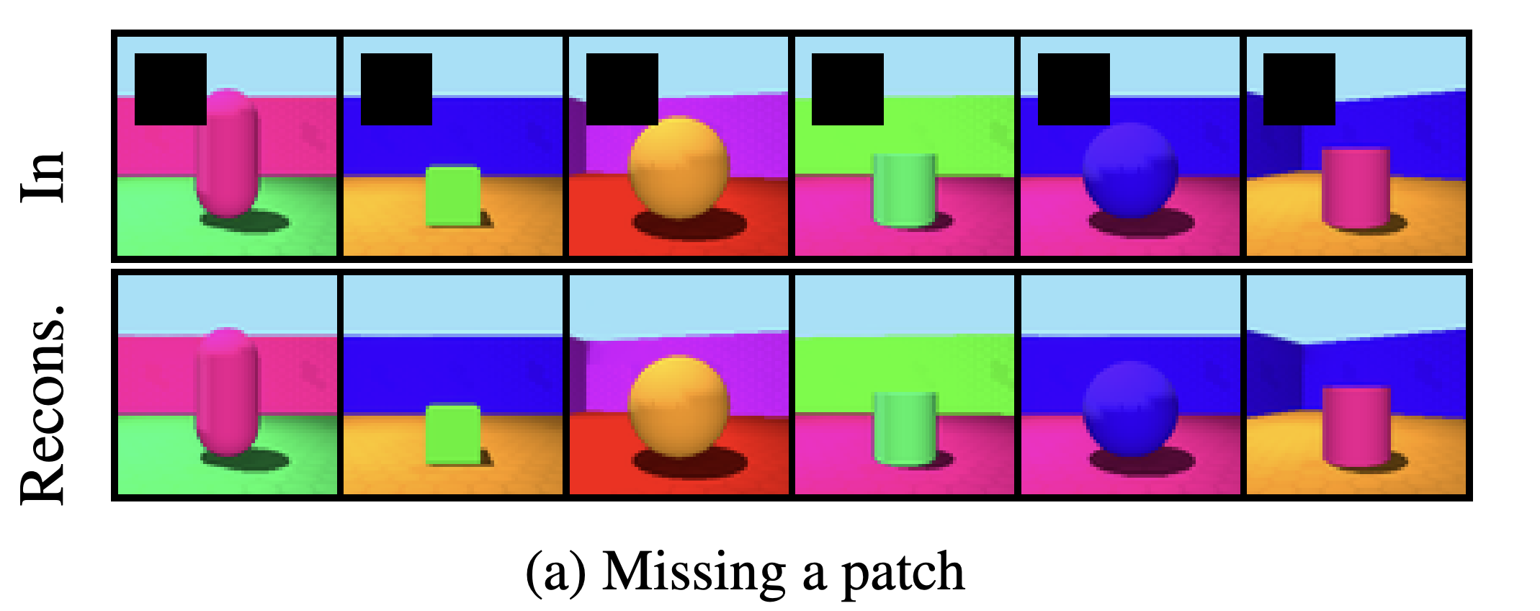
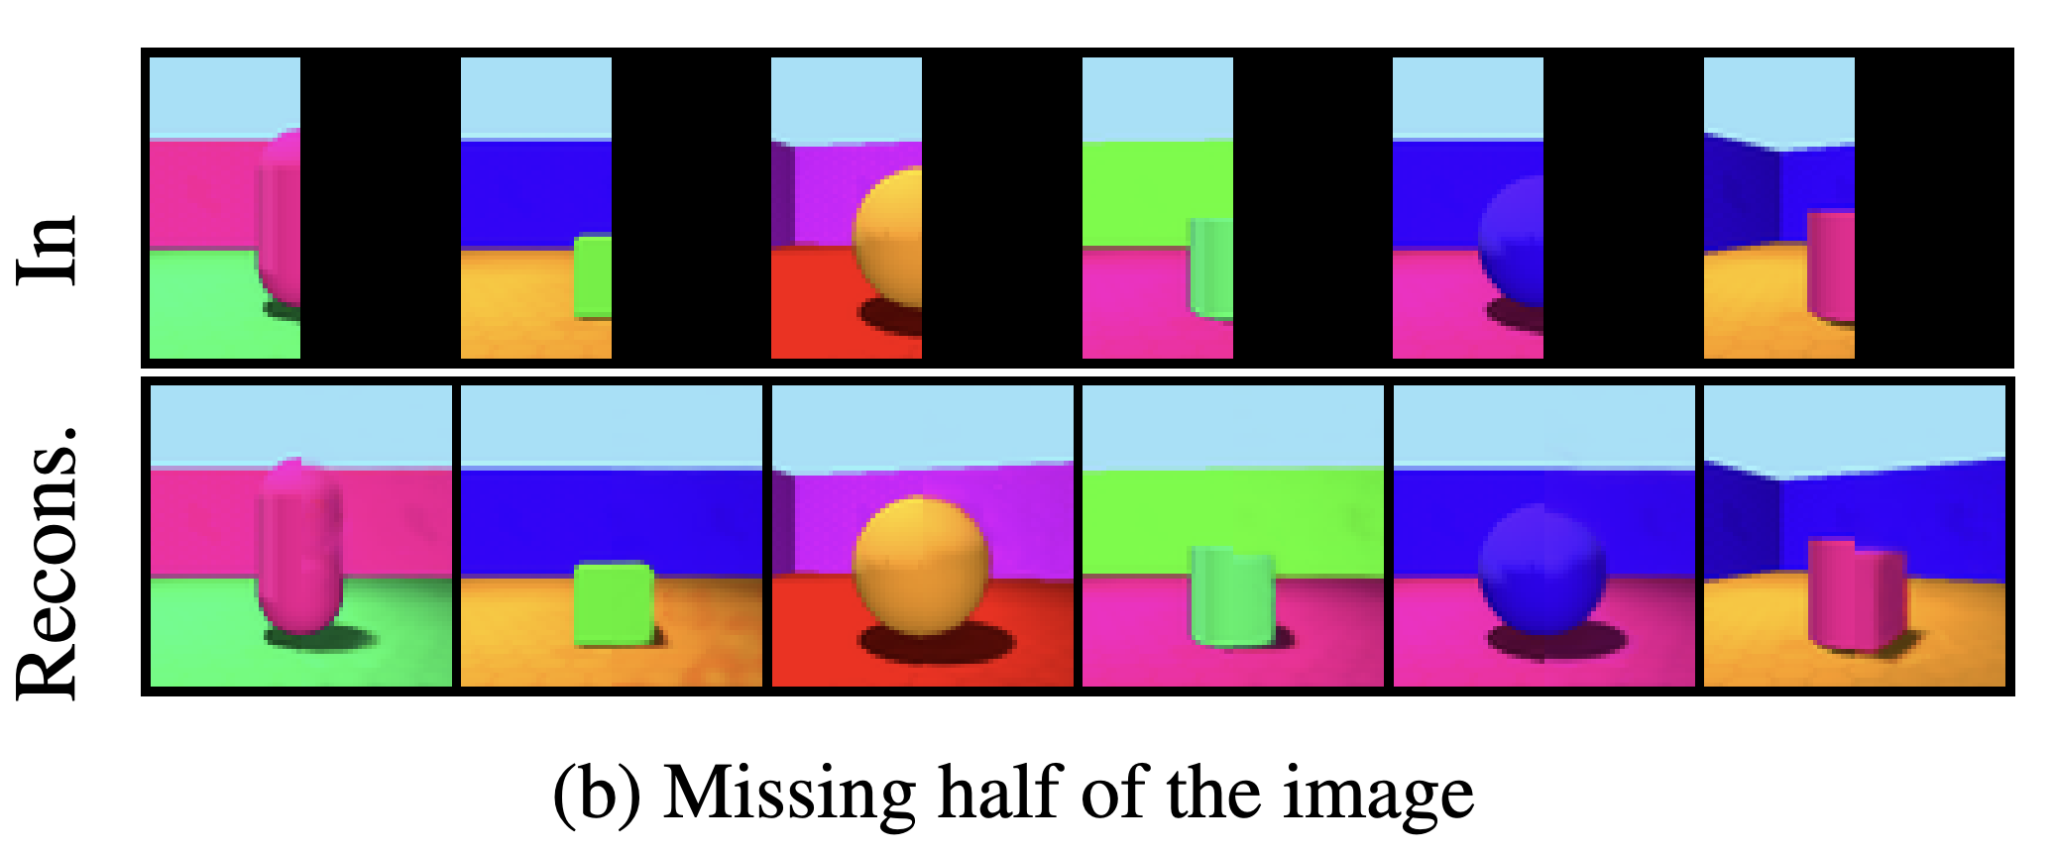
Results
Our method allows for efficient conditional generation via inference.

Slide 17
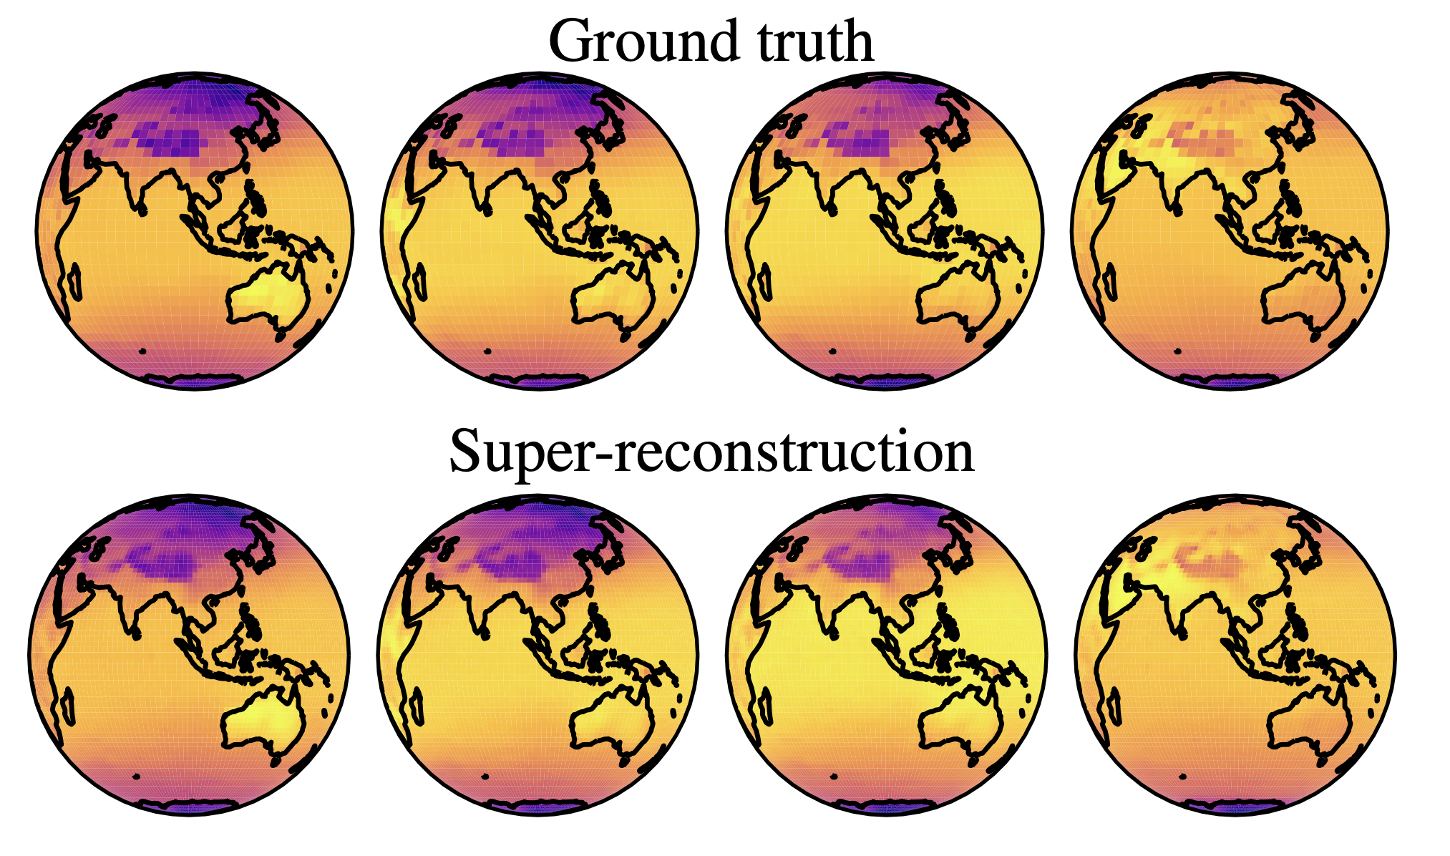
Results
Our method allows for efficient conditional generation via inference.

Slide 18
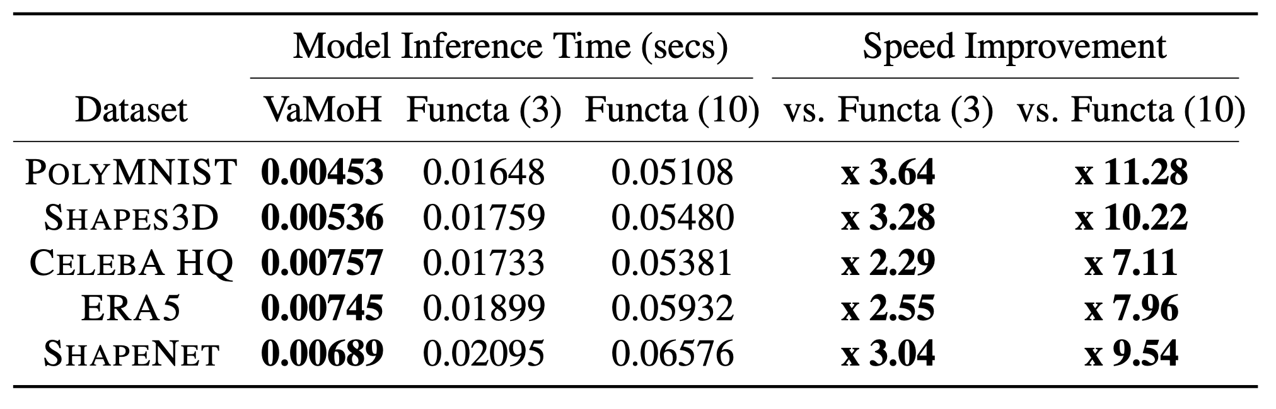
Results
We achieve a 7-11 times faster inference than the alternative!

Slide 19
Conclusion
Thanks to learning distributions of functions, our proposed VAMoH can:
“Sample” neural networks for generating new functions.
Infer the latent representation of a neural network for conditionally generating data.
Use the same neural architecture independently of the nature of the data.
Easily perform the conditional generation at any desired resolution, while being:
Robust to partially observed data.
Expressive for generating high-quality data.
Efficient in terms of inference.

Slide 20
References
[1] Goodfellow, I., Pouget-Abadie, J., Mirza, M., Xu, B., Warde-Farley, D., Ozair, S., ... & Bengio, Y. (2014). Generative adversarial nets. Advances in neural information processing systems, 27.
[2] Kingma, D. P., & Welling, M. (2013). Auto-encoding variational bayes. arXiv preprint arXiv:1312.6114.
[3] Ho, J., Jain, A., & Abbeel, P. (2020). Denoising diffusion probabilistic models. Advances in neural information processing systems, 33, 6840-6851.
[4] Song, Y., & Ermon, S. (2019). Generative modeling by estimating gradients of the data distribution. Advances in neural information processing systems, 32.
[5] LeCun, Y., Chopra, S., Hadsell, R., Ranzato, M., & Huang, F. (2006). A tutorial on energy-based learning. Predicting structured data, 1(0).
[6] Simonyan, K., & Zisserman, A. (2014). Very deep convolutional networks for large-scale image recognition. arXiv preprint arXiv:1409.1556.
[7] Dosovitskiy, A., Beyer, L., Kolesnikov, A., Weissenborn, D., Zhai, X., Unterthiner, T., ... & Houlsby, N. (2020). An image is worth 16x16 words: Transformers for image recognition at scale. arXiv preprint arXiv:2010.11929.
[8] Hochreiter, S., & Schmidhuber, J. (1997). Long short-term memory. Neural computation, 9(8), 1735-1780.
[9] Vaswani, A., Shazeer, N., Parmar, N., Uszkoreit, J., Jones, L., Gomez, A. N., ... & Polosukhin, I. (2017). Attention is all you need. Advances in neural information processing systems, 30.
[10] Sitzmann, V., Martel, J., Bergman, A., Lindell, D., & Wetzstein, G. (2020). Implicit neural representations with periodic activation functions. Advances in neural information processing systems, 33, 7462-7473.

Slide 21
References
[11] Mescheder, L., Oechsle, M., Niemeyer, M., Nowozin, S., & Geiger, A. (2019). Occupancy networks: Learning 3d reconstruction in function space. In Proceedings of the IEEE/CVF conference on computer vision and pattern recognition (pp. 4460-4470).
[12] Stanley, K. O. (2007). Compositional pattern producing networks: A novel abstraction of development. Genetic programming and evolvable machines, 8, 131-162.
[13] Ha, D., Dai, A. M., and Le, Q. V. Hypernetworks. In International Conference on Learning Representations, 2017.
[14] Wu, W., Qi, Z., and Fuxin, L. Pointconv: Deep convolutional networks on 3d point clouds. In Proceedings of the IEEE/CVF Conference on Computer Vision and Pattern Recognition, pp. 9621–9630, 2019.
[15] Rombach, R., Blattmann, A., Lorenz, D., Esser, P., & Ommer, B. (2022). High-resolution image synthesis with latent diffusion models. In Proceedings of the IEEE/CVF conference on computer vision and pattern recognition (pp. 10684-10695).
[16] Rezende, D. and Mohamed, S. Variational inference with normalizing flows. In International Conference on Machine Learning, 2015.
[17] Dupont, E., Teh, Y. W., and Doucet, A. Generative models as distributions of functions. In International Conference on Artificial Intelligence and Statistics, pp. 2989–3015. PMLR, 2022a.
[18] Dupont, E., Kim, H., Eslami, S. A., Rezende, D. J., and Rosenbaum, D. From data to functa: Your data point is a function and you can treat it like one. In International Conference on Machine Learning, pp. 5694–5725. PMLR, 2022

Slide 22
Thank you!
[Paper]
[Code]

Slide 23
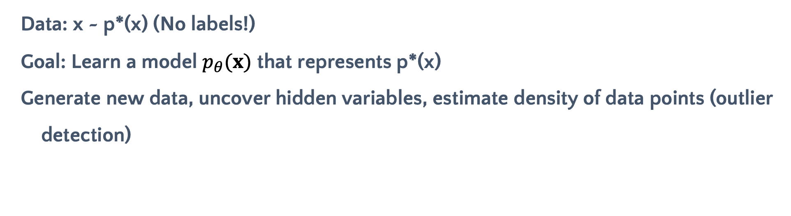
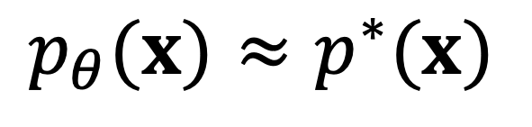
Latent Variable Models
Data: x ~ p*(x) (No labels!)
Goal: Learn a model $p_{θ}(x)$ that represents p*(x)
Generate new data, uncover hidden variables, estimate density of data points (outlier detection)
$$p_{θ}(x)≈p^{∗}(x)$$
The marginal distribution $p_{θ}(x)$ can be very complex depending on your task.

Slide 24
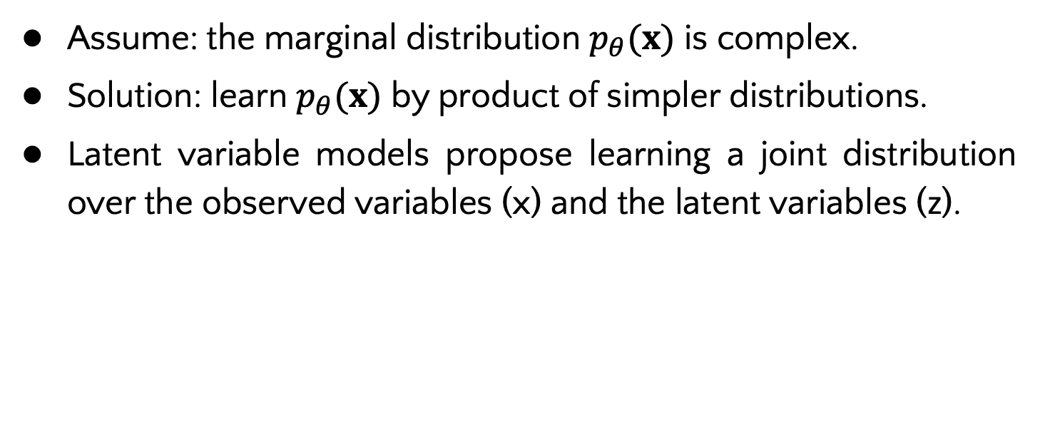
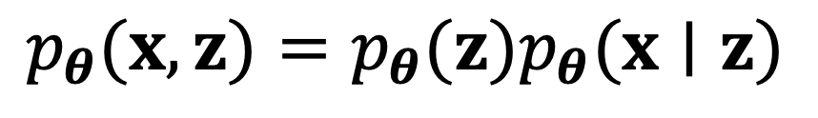
Theoretical Background
Latent Variable Models
Assume: the marginal distribution $p_{θ}(x)$ is complex.
Solution: learn $p_{θ}(x)$ by product of simpler distributions.
Latent variable models propose learning a joint distribution over the observed variables (x) and the latent variables (z).
$$p_{θ}(x,z)=p_{θ}(z)p_{θ}(x∣z)$$
A latent (hidden) variable is an unobserved variable, which is assumed to be generating the observed data (x).
Notes:
Latent variable models are very handy frameworks that are widely used in generative modeling. The motivation behind the latent variable models is as the following. Let us assume that the marginal distiribution p theta of x is very complex. We can try to learn it by a product of simpler distributions.
Latent variable models propose a simple graphical model that introduces latent variables zii. The latent variables are not observed and they are assumed to be creating the data x. Therefore, latent variable models aim to learn a joint distribution over the x and z, which can be written as a product of prior and likelihood.

Slide 25
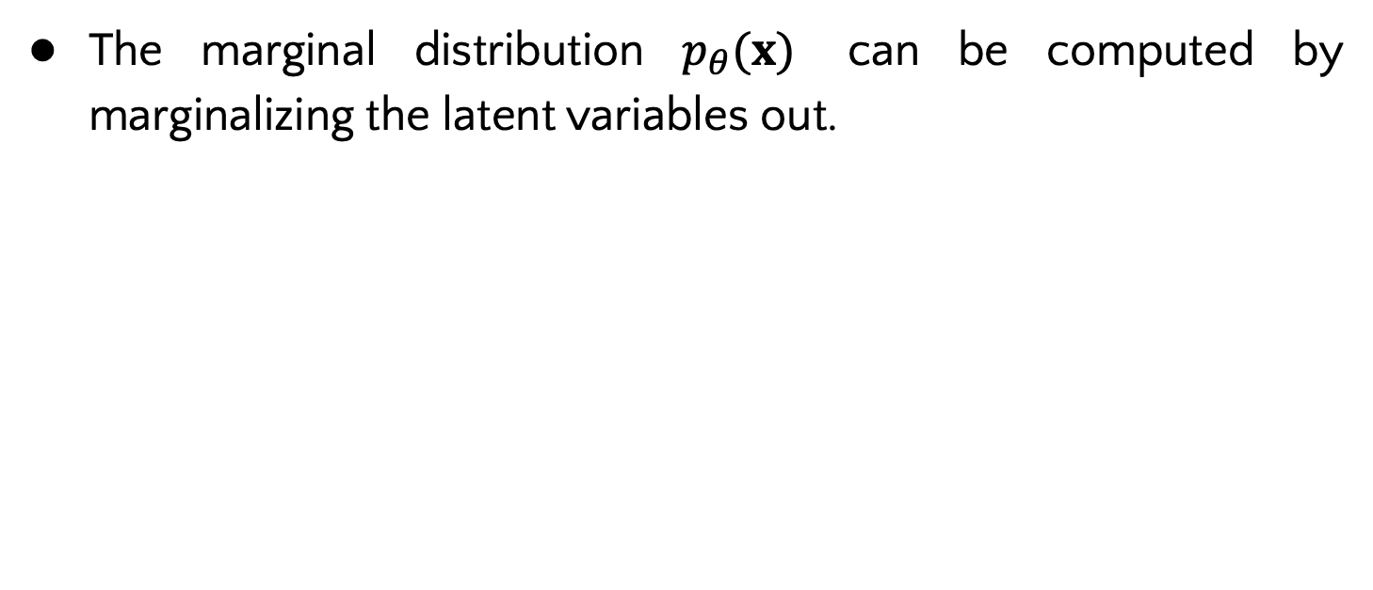
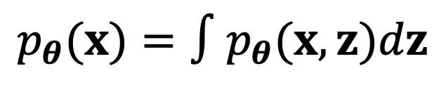
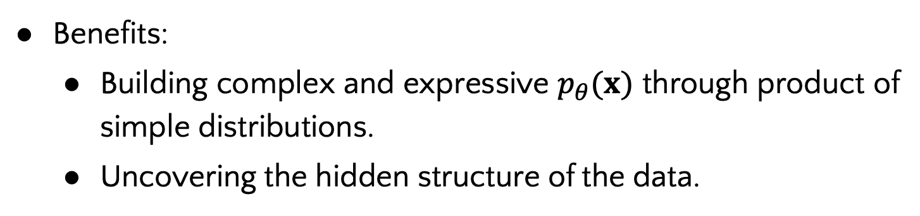

Theoretical Background
Latent Variable Models
The marginal distribution $p_{θ}(x)$ can be computed by marginalizing the latent variables out.
$$p_{θ}(x,z)=p_{θ}(z)p_{θ}(x∣z)$$
$$p_{θ}(x)=∫p_{θ}(x,z)dz$$
Benefits:
Building complex and expressive $p_{θ}(x)$ through product of simple distributions.
Uncovering the hidden structure of the data.
Notes:
after we learn the joint distribution p of (x and z), p of x can be computed by integrating the latent variables out. To sum up, latent varaible models offer simple and expressive modeling of the marginal distribution. Also, it uncovers the hidden structure of data given that we learn a distribution over the hidden variables zii.

Slide 26


Theoretical Background
Latent Variable Models
The latent variable models learn a distribution over the latent variables.
Likelihood
Prior
$$p_{θ}(z∣x)=\frac{p_{θ}(x∣z)p_{θ}(z)}{p_{θ}(x)}$$
Posterior
Bayes’ theorem
Evidence
Problem: the posterior computation is intractable due to high dimensional integral in the computation of the evidence.
$$p_{θ}(x)=∫p_{θ}(x,z)dz$$
Notes:
Okay so far so good, but now we need to infer latent variables given the data. this can be done by calculating the posterior through bayes theorem. The problem is that the posterior computation is intractable due to high dimensional (intractable) integral in the computation of the evidence which is the denominator.

Slide 27





Theoretical Background
Variational Inference
Solution: Approximate the posterior by using variational inference methods by solving an optimization problem. The KL term stands for the Kullback-Leibler divergence.
$$q_{φ}(z∣x)$$
Variational posterior
$$p_{θ}(z∣x)$$
Target posterior
$$q_{φ}(z∣x)≈p_{θ}(z∣x)$$
Aim
$$q_{φ}^{∗}(z∣x)=\underset{φ}{argmin}𝒟_{KL}\left[q_{φ}(z∣x)∥p_{θ}(z∣x)\right]$$
Objective function
Illustration describing the variational inference methods.
Image is adapted from Altosaar, J., Probabilistic Modeling of Structure in Science: Statistical Physics to Recommender Systems, Ph.D. Thesis, PrincetonUniversity, 2020.
Notes:
In order to approximate the posterior, we can utilize variational inference methods. Variational inference methods find best posterior approximation through solving an optimization problem. First, the family of the variational distribution is selected to define the set of possible approximate distributions. we generally prefer q to be a Gaussian distribution since it is easy to work on. The aim of the optimization procedure is finding the best distribution q of z given x, with variational parameters phi, that approximates the posterior p of z given x.
This optimization process minimizes the KL divergence between variational posterior and the target posterior. Here, KL divergence is calculating a metric that shows how much information is lost when the candidate distribution q is used instead of the reference distribution p.

Slide 28

Theoretical Background
Variational Inference
$$logp_{θ}(x)=𝒟_{KL}\left[q_{φ}(z∣x)∥p_{θ}(z∣x)\right]+𝔼_{q_{φ}(z∣x)}\left[logp_{θ}(x∣z)\right]−𝔼_{q_{φ}(z∣x)}\left[log\frac{logq_{φ}(z∣x)}{p_{θ}(z)}\right]$$
Log marginal likelihood
Objective function to minimize
Evidence lower bound (ELBO)
Maximizing the ELBO term has two important effects:
It maximizes the log marginal likelihood, which builds a better generative model.
It minimizes the KL divergence of the variational posterior q from the true posterior p, which approximates a better posterior.
$$logp_{θ}(x)≥ℒ_{θ,φ}(x)=𝔼_{q_{φ}(z∣x)}\left[logp_{θ}(x∣z)\right]−𝔼_{q_{φ}(z∣x)}\left[log\frac{q_{φ}(z∣x)}{p_{θ}(z)}\right]$$
Evidence lower bound (ELBO)
Kingma, D. P. and M. Welling, “An Introduction to Variational Autoencoders”, Foundations and Trends in Machine Learning, Vol. 12, No. 4, pp. 307–392, 2019.
Notes:
To sum up, Maximizing the elbo term has two important outcomes, it maximizes the log marginal likelihood which means our generative model gets better, also it minimizes the KL term which generates a better variational posterior which means we infer latent variables better.

Slide 29





Theoretical Background
Variational Auto-Encoder
Maximizing the ELBO term has two important effects:
It maximizes the log marginal likelihood, which builds a better generative model.
It minimizes the KL divergence of the variational posterior q from the true posterior p, which approximates a better posterior.
$$logp_{θ}(x)≥ℒ_{θ,φ}(x)=𝔼_{q_{φ}(z∣x)}\left[logp_{θ}(x∣z)\right]−𝒟_{KL}\left[q_{φ}(z∣x)∥p_{θ}(z)\right]$$
Reconstruction
Regularization
$$p_{θ}(z)$$
$$q_{φ}(z∣x)$$
$$p_{θ}(x∣z)$$
VAE maximizes the ELBO w.r.t. the parameters $θ$ and $φ$ jointly.
Kingma, D. P., “Variational Inference Deep Learning: A New Synthesis”, PhD Thesis, 2017.
Notes:
Okay now lets move to the deep learning side. A Variational autoencoder is a probabilistic generative model, which aims to learn best parameters theta and phi by maximizing the ELBO term using the data x.
If you decompose the ELBO term it is very intuitive,
-the first term is the expected log likelihood given the inferred latent variables. it quantifies the goodness of the reconstructions. -whereas the second term regularizes the variational posterior with the prior p of zi.

Slide 30

Theoretical Background
Discretized Logistic Likelihood
Likelihood
Notes:
Okay now lets move to the deep learning side. A Variational autoencoder is a probabilistic generative model, which aims to learn best parameters theta and phi by maximizing the ELBO term using the data x.
If you decompose the ELBO term it is very intuitive,
-the first term is the expected log likelihood given the inferred latent variables. it quantifies the goodness of the reconstructions. -whereas the second term regularizes the variational posterior with the prior p of zi.

Slide 31

VAMoH
Precision and Recall

Slide 32

VAMoH
Precision and Recall

Slide 33

VAMoH
Details

Slide 34

VAMoH
Details

Slide 35

VAMoH
Details

Slide 36

Functa Architecture
Base Modulations (Learn for training data)
Latent Modulations (Learn for training & test data)

